Slide 1

#DDDAdelaide / @DDDAdelaide

Slide 2














GOLD SPONSORS
SA SPONSORS
WITH SUPPORT FROM

Slide 3
Documentation for Developers
And friends…

Slide 4
Documentation for Developers
And friends…

Slide 5
Developers
Do
Documentation
ADELAIDE

Slide 6


About Me
Currently
Practice Director
Principal Consultant
CTO
Previously
Various Enterprise, Startup, and Freelance Things

Slide 7
Why do we document things?
should we
Communicate complex systems easier
Reduce cognitive load
Team member on-boarding
Software and Solution Architecture
Architectural Guidelines and Principles
Decisions and rationale
Disaster recovery
Future you will forget what the heck you did this week!

Slide 8
So, then why aren’t we doing this?
Documentation is boring
Documentation gets out of date and must be maintained
It breaks the flow of software development
Often requires special tooling, or licenses
Diagramming tools are often hard to version control
Perfect is the enemy of done

Slide 9
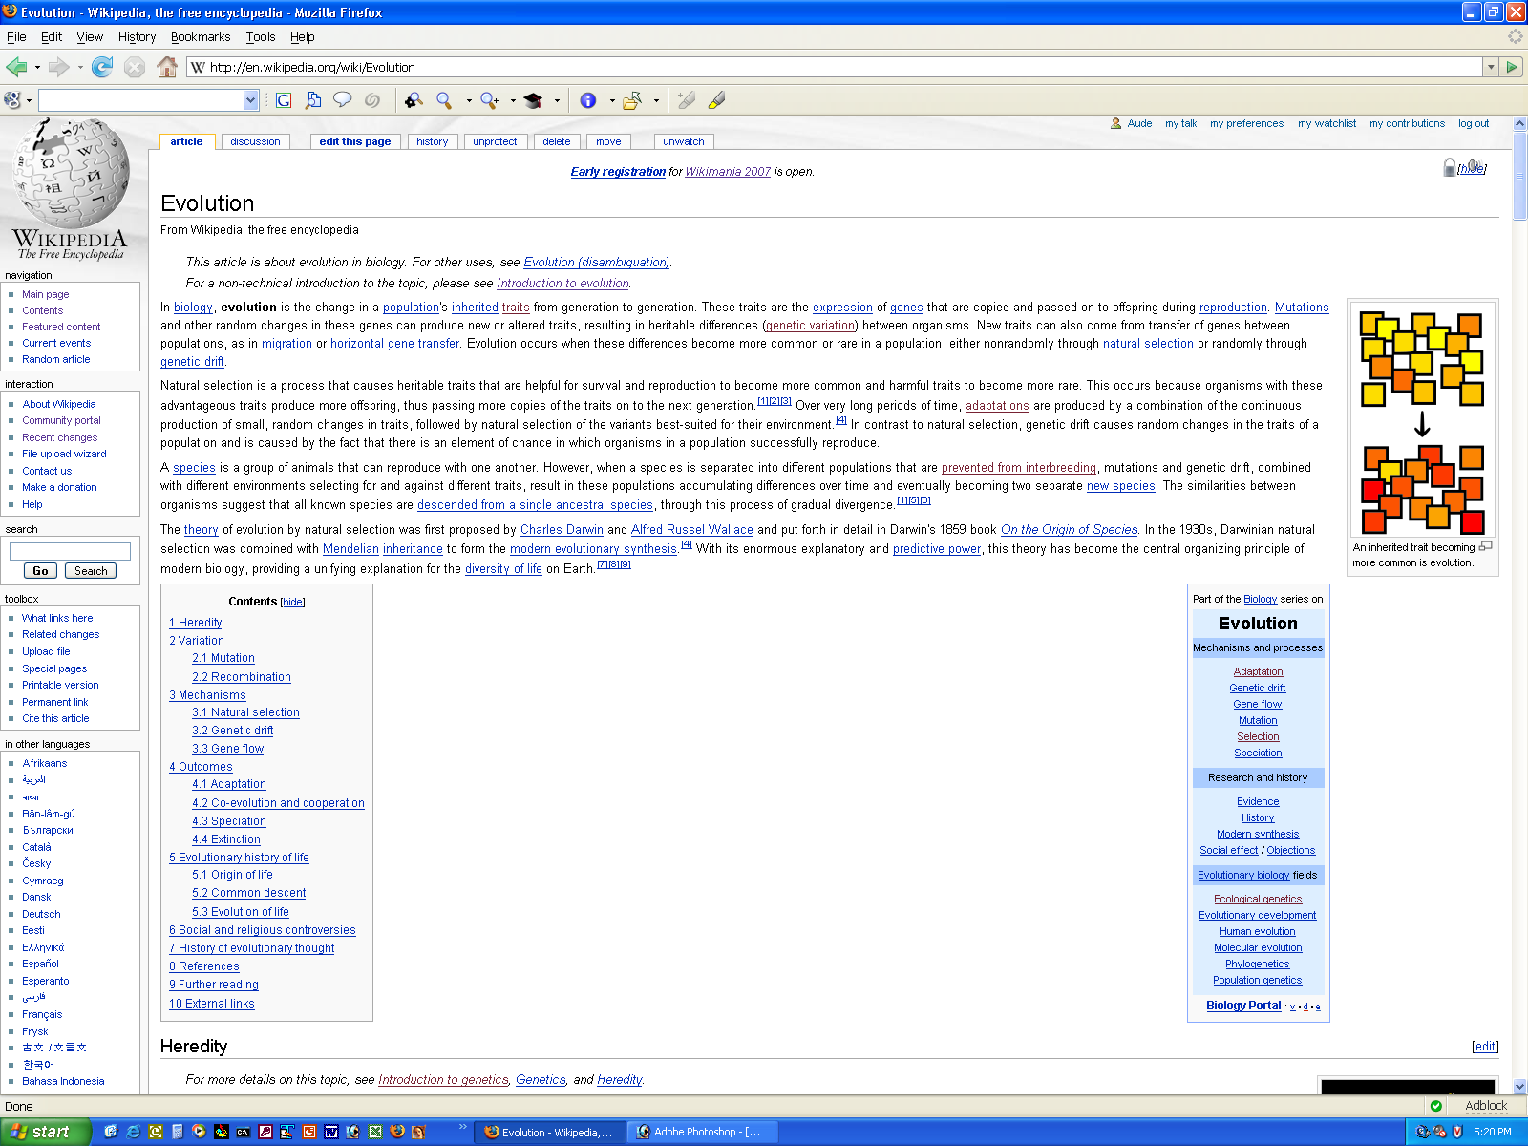
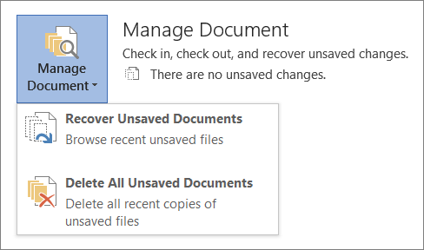
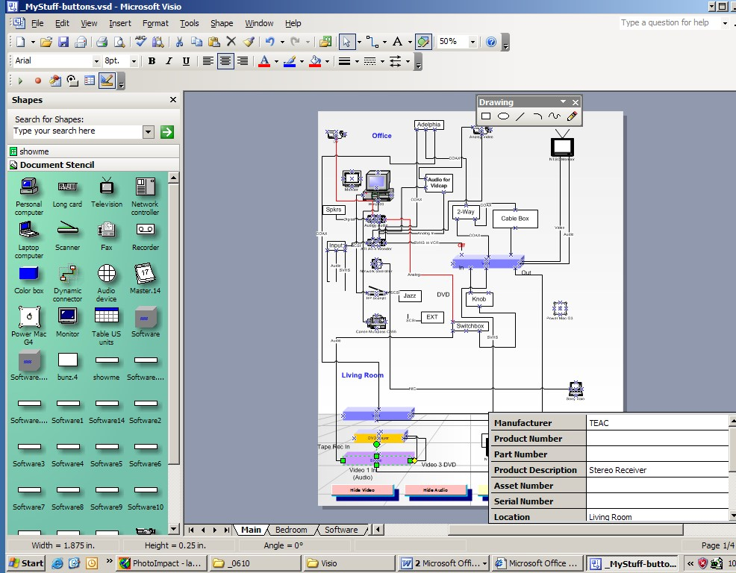
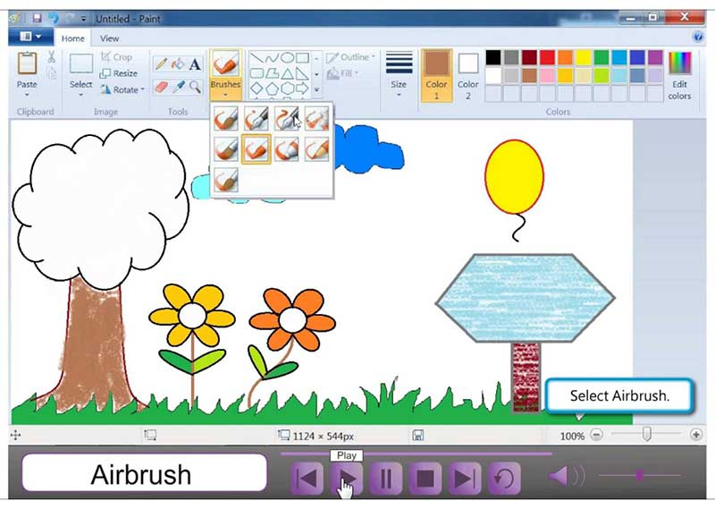
Traditional Approaches
Wikis, Confluence
Word Documents
Specialised tools
Visio
Draw.io
Paint
Illustration ToolS

Slide 10
A possible solution?
Adopt “Documentation as Code”
Favour the separation of structure from presentation
Minimise requirement for extra tooling
Version controlled in git
Be pragmatic, start simple, scale up

Slide 11
Pros
Cons
Version controllable / diffable
Simple to use / learn
Using a DSL vs just diagrams means there is context
Cross platform
Minimal tooling
Can generate images / pdf / ppt
Minimal licensing
The learning curve
Less accessible to non-tech folk
Harder to search & aggregate (solvable)
Code sprawl (solvable)

Slide 12
A consulting story
A new project
A handful of repositories
No documentation
Where do we start?

Slide 13
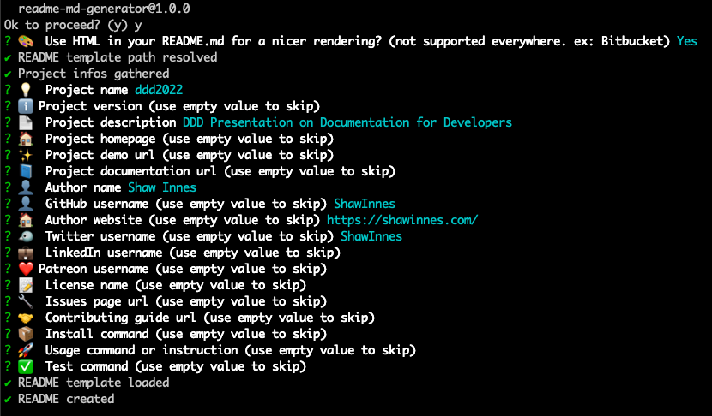
Markdown README
A quick intro for onboarding
Use a template for consistency
Customise for your company
Use readme-md-generator
Or Google for examples
Notes:
What’s the minimum amount of information someone needs to get up and running
We always look at READMEs as part of our interview process
https://github.com/kefranabg/readme-md-generator

Slide 14
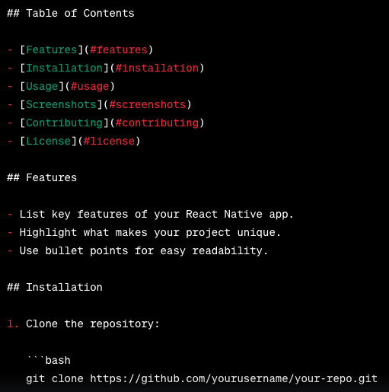
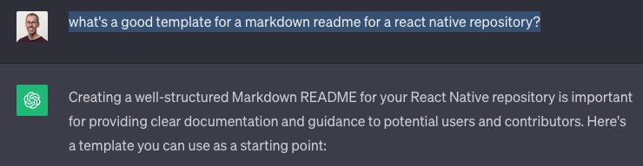

Markdown README
A quick intro for onboarding
Use a template for consistency
Customise for your company
Google for examples
Ask ChatGPT
Notes:
What’s the minimum amount of information someone needs to get up and running
We always look at READMEs as part of our interview process
https://github.com/kefranabg/readme-md-generator

Slide 15
Tracking Decisions
Markdown Decision Records (MADR)
Context/Problem
Considered Options
Decision
Consequences
Create an index for easy reference
Notes:
As we start to understand decisions that have been made either through inspection or by talking to the team, we want to capture those
On a new project we want to start with these
Minimise the amount of time revisiting made decisions every time a new person joins

Slide 16
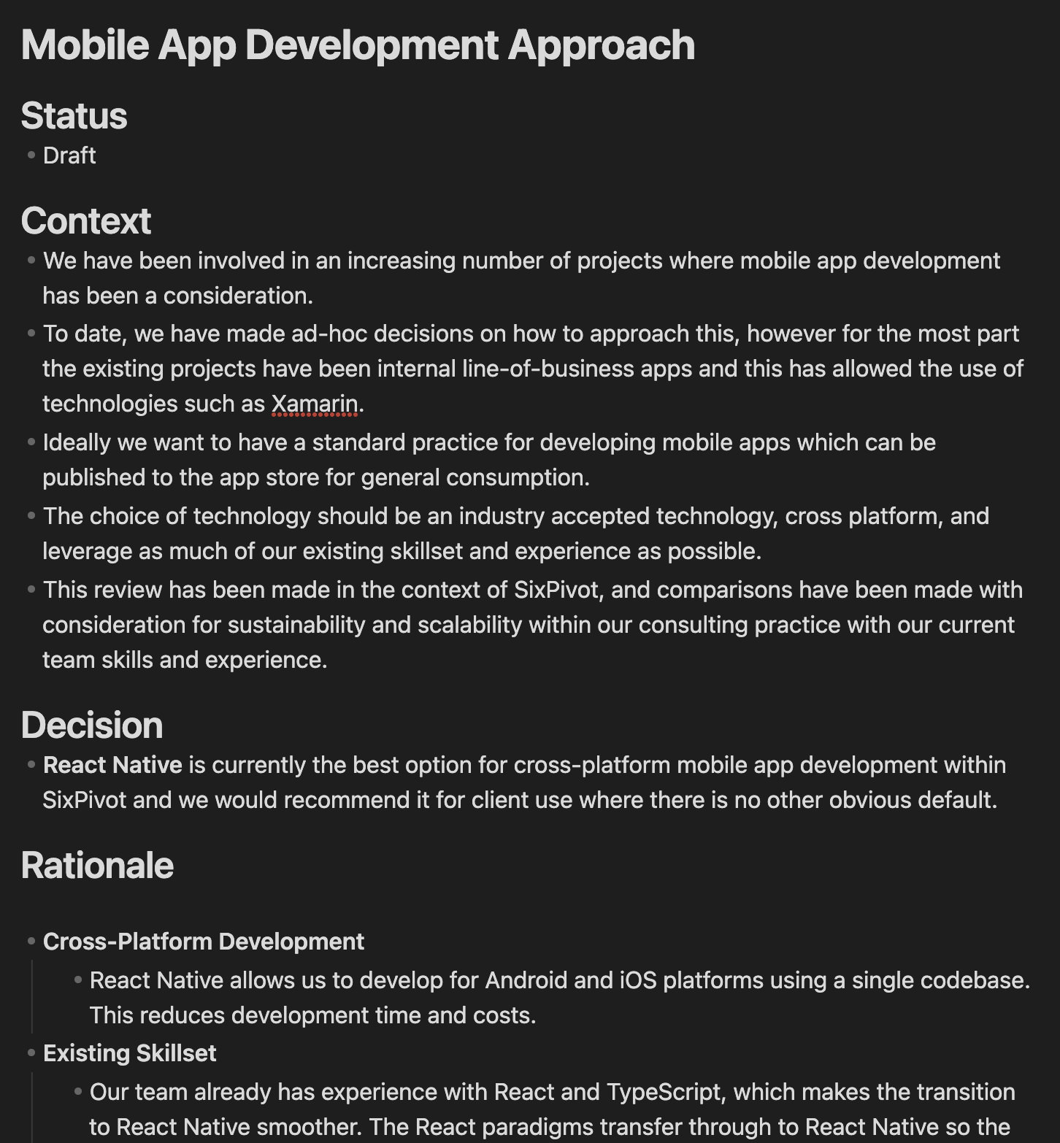
Notes:
As we start to understand decisions that have been made either through inspection or by talking to the team, we want to capture those
On a new project we want to start with these
Minimise the amount of time revisiting made decisions every time a new person joins

Slide 17
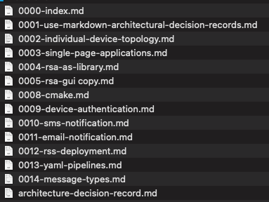
Markdown Decision REcords
Notes:
As we start to understand decisions that have been made either through inspection or by talking to the team, we want to capture those
On a new project we want to start with these
Minimise the amount of time revisiting made decisions every time a new person joins

Slide 18
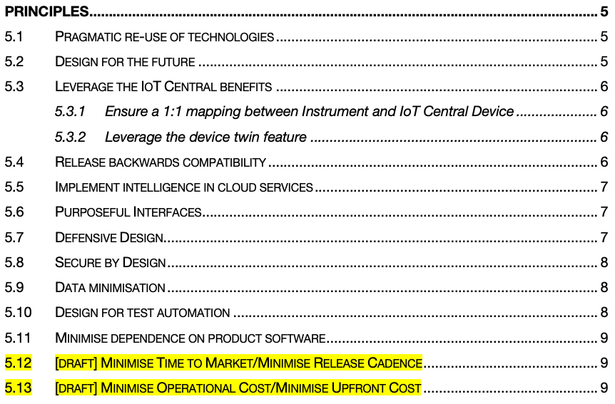
Architectural Guidance
Architecture Principles
Capture expectations/assumptions
Allow teams to make decisions
Could this meeting have been a Principle?
Notes:
My pet hate is having to enlist the opinion of an architect every time you want to extend a solution
Can we come up with some guidelines and principles to help push decision making to the development teams?
Then if something isn’t covered in the architectural principles, consult an architect.

Slide 19
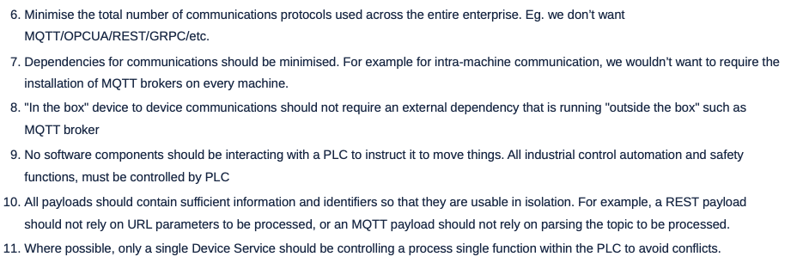
Architectural Principles
Well-defined principles
Name: Succinct, easy to remember, and carries the essence of the rule (few words)
Statement: Unambiguous statement defining the rule (1 to 3 sentences)
Rationale: Why is this rule important, particularly in terms of business benefits.
Implications: Identifies explicitly how the rule affects the business, teams, etc.
Notes:
1. **Name**: A principle's name should be crisp, resonant, and reflective of its core idea. Think of it as a label that encapsulates its essence in a memorable way.
2. **Statement**: The statement should be clear and concise, avoiding technical jargon when possible. This ensures that the principle is comprehensible and can be consistently applied by everyone, from IT personnel to business executives.
3. **Rationale**: The reasoning behind a principle provides the 'why,' connecting it to tangible business outcomes. It helps stakeholders understand the value and importance of adhering to the principle.
4. **Implications**: Outlining the implications clarifies the expected changes or actions required. It should illuminate the impact on processes, organizational structures, and the behavior of teams.

Slide 20
A picture is worth a thousand words…

Slide 21
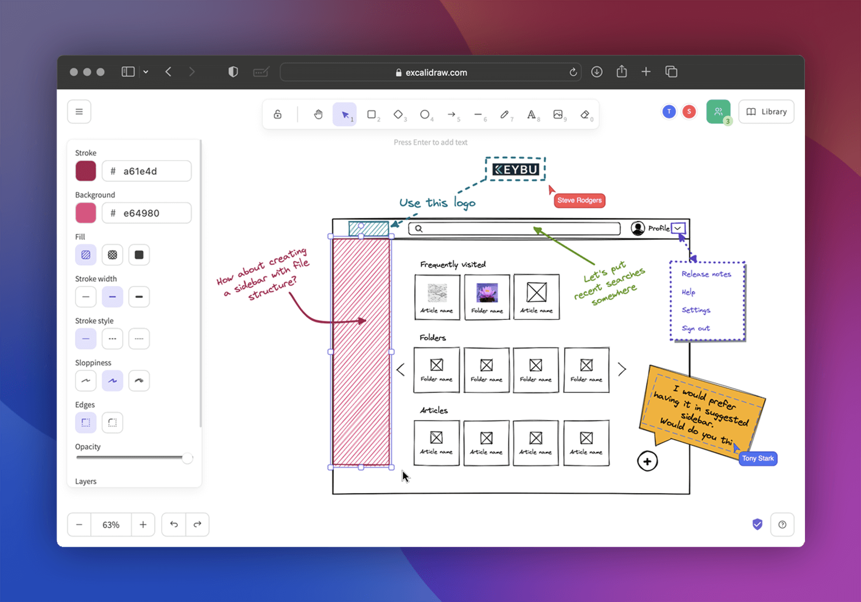
Diagramming - Excalidraw
Traditional diagramming
Browser-based
Open JSON format file
Notes:
https://plantuml.com/
https://crashedmind.github.io/PlantUMLHitchhikersGuide/
https://github.com/plantuml/plantuml-stdlib

Slide 22

Diagramming - PlantUML
Text-based diagramming
multiple diagram types
Sequence, Class, Activity, ERD
Extensible with Libraries
Azure, Kubernetes, AWS, C4…
Tooling
VS Code, JetBrains, Others…
Markdown wikis
* Mermaid is another good option
Notes:
https://plantuml.com/
https://crashedmind.github.io/PlantUMLHitchhikersGuide/
https://github.com/plantuml/plantuml-stdlib

Slide 23
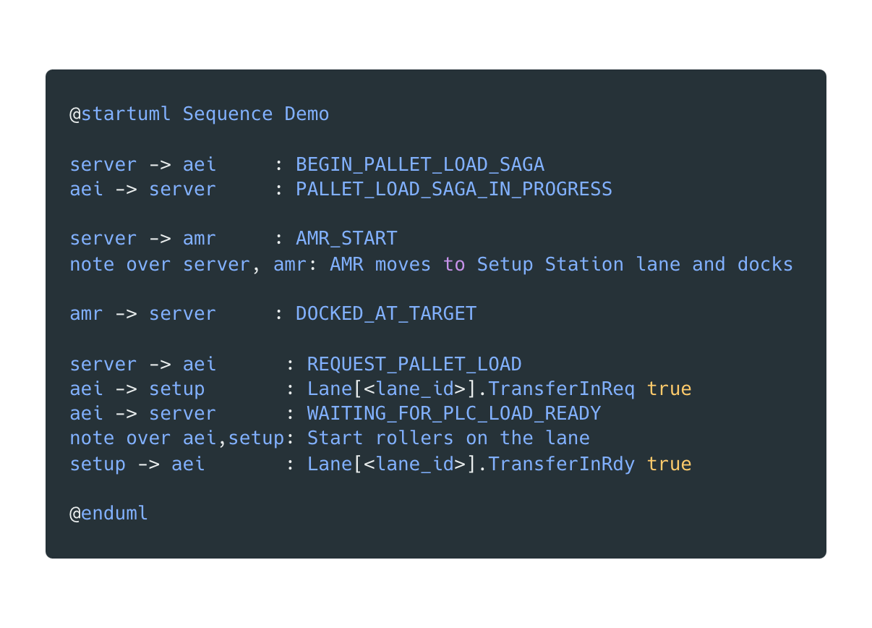
Notes:
01-plantuml-sequence.puml

Slide 24
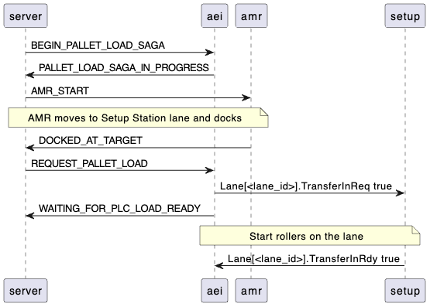
Notes:
01-plantuml-sequence.puml

Slide 25
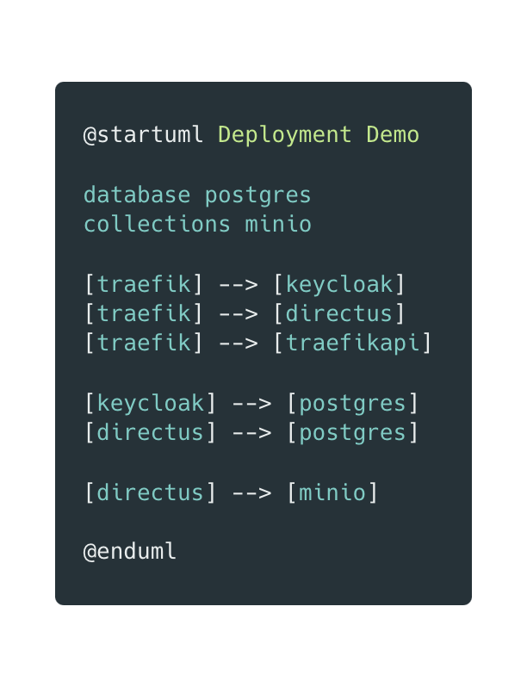
Notes:
01-plantuml-sequence.puml

Slide 26
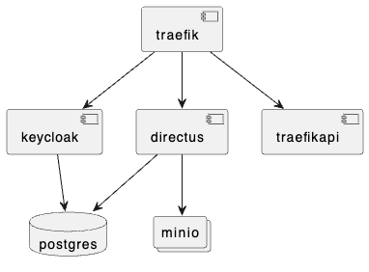
Notes:
01-plantuml-sequence.puml

Slide 27
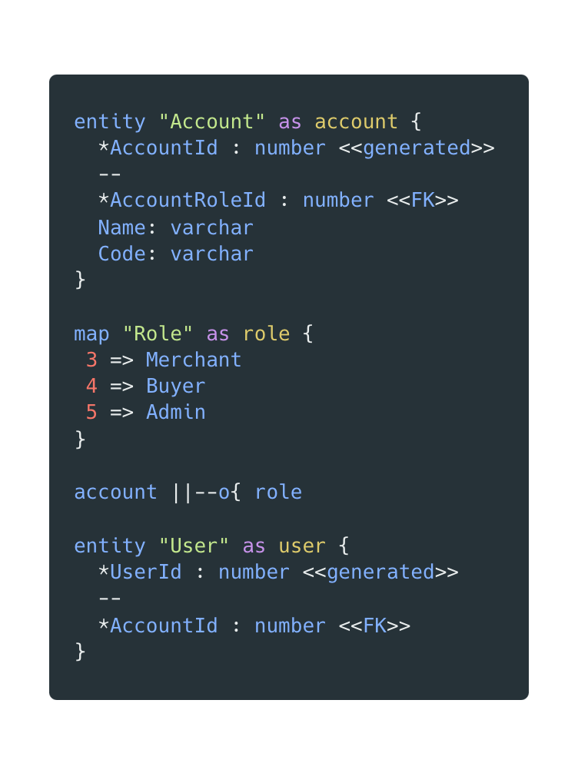
Notes:
01-plantuml-sequence.puml

Slide 28
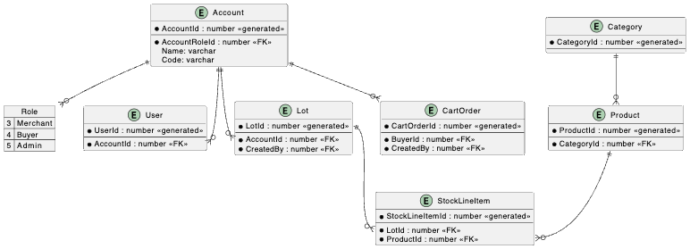
Notes:
01-plantuml-sequence.puml

Slide 29
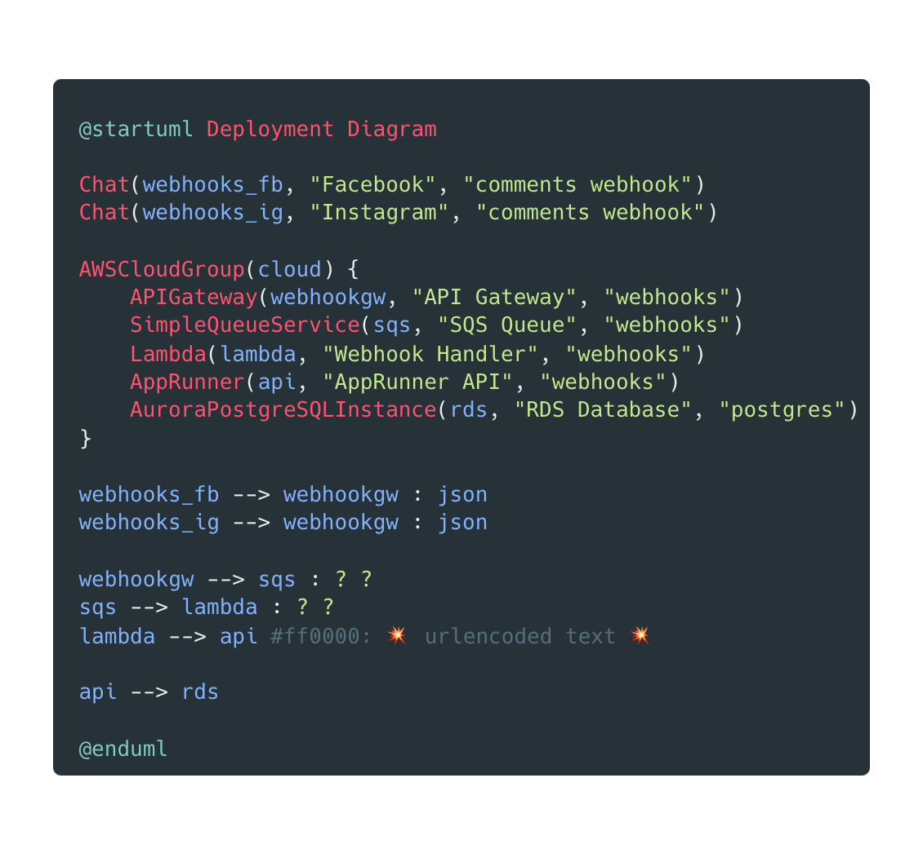
Notes:
01-plantuml-sequence.puml

Slide 30
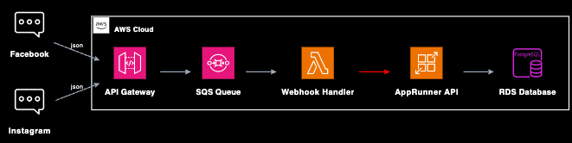
Notes:
01-plantuml-sequence.puml

Slide 31
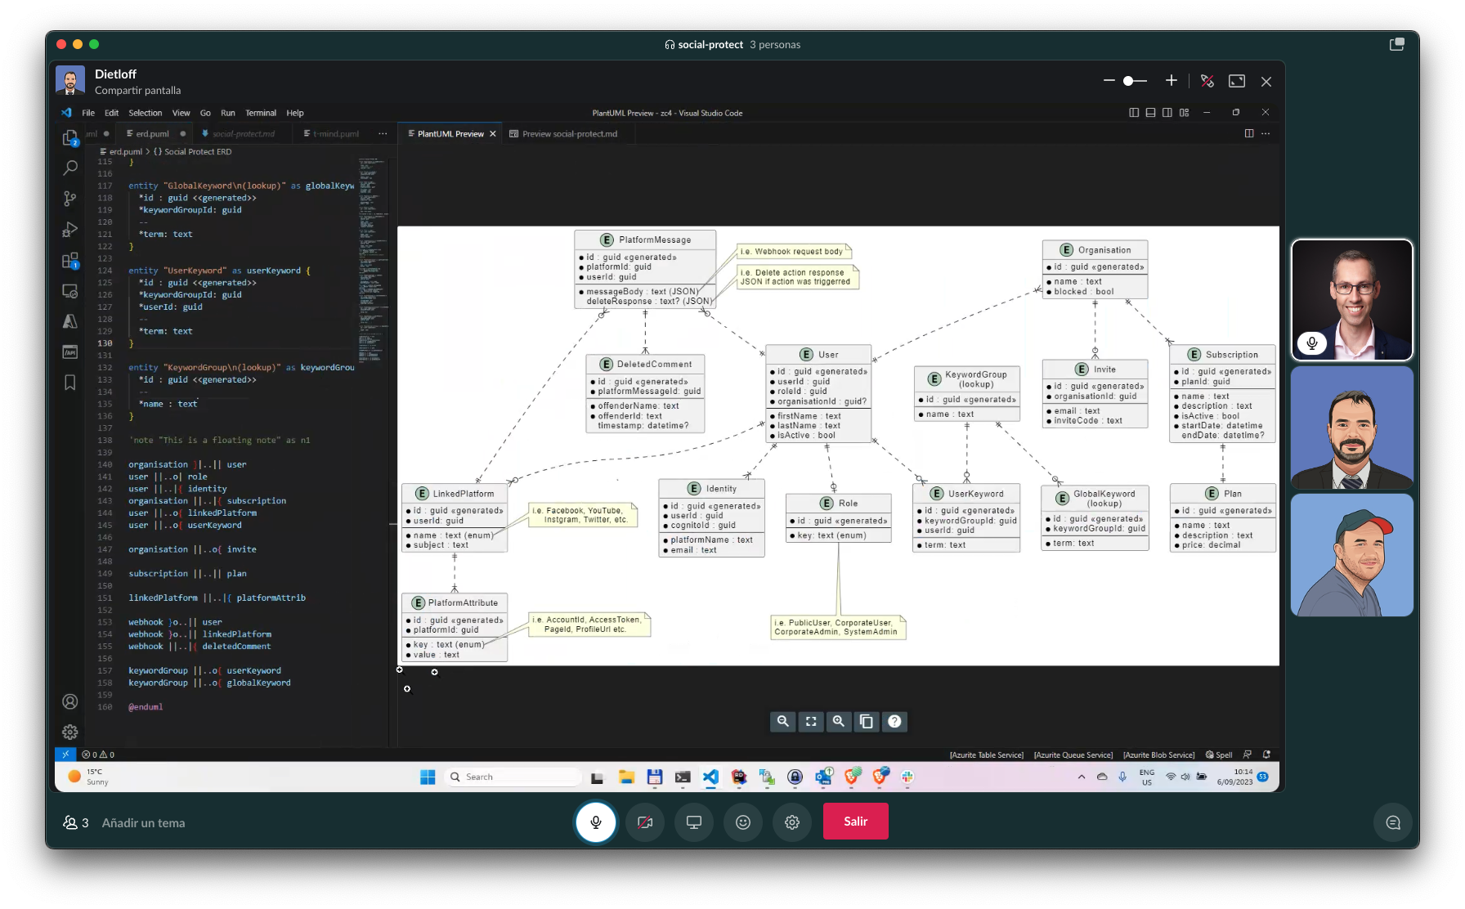

Slide 32
C4 Model
Simple abstractions & Standard diagram types
Helps avoid overly-complex diagrams
Context (level 1): system scope, users and other systems
Container (level 2): represents an application or a data store
web application, mobile app, serverless function, embedded device
Component (level 3): internals of a container
Code (level 4): class-level decomposition
Deployment: optional, and very useful
Notes:
I’ve found C4 to be really beneficial at stopping myself and others from trying to cram everything onto a single diagram
https://c4model.com/
https://adrianvlupu.github.io/C4-Builder/
https://github.com/plantuml-stdlib/C4-PlantUML
https://c4model.com/review/

Slide 33
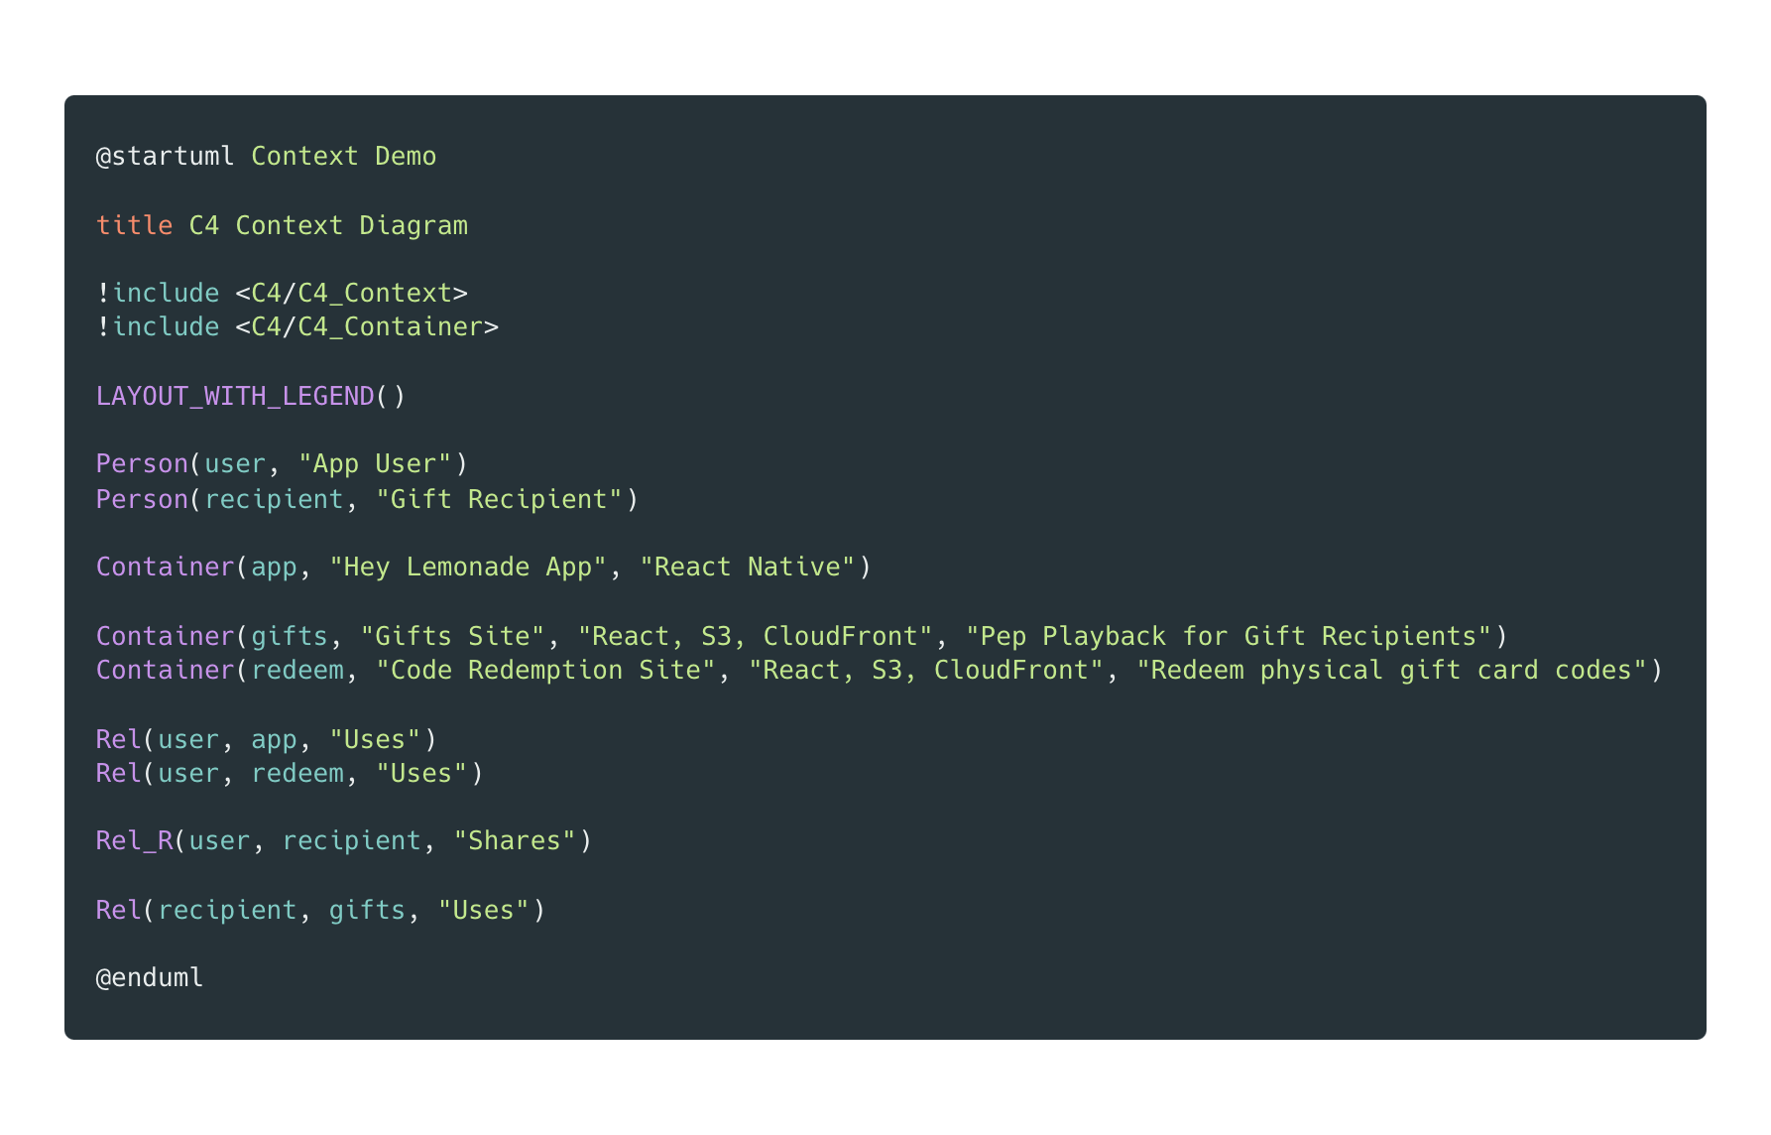
Notes:
01-plantuml-sequence.puml

Slide 34
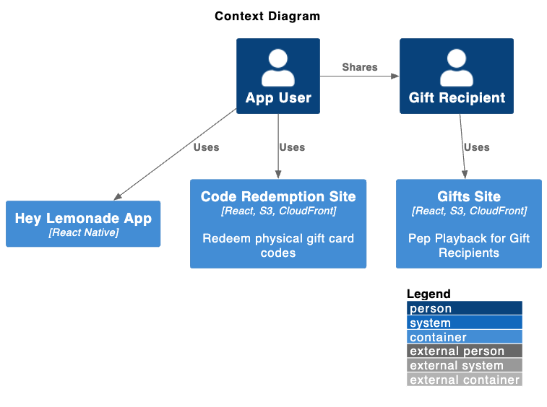
Notes:
01-plantuml-sequence.puml

Slide 35
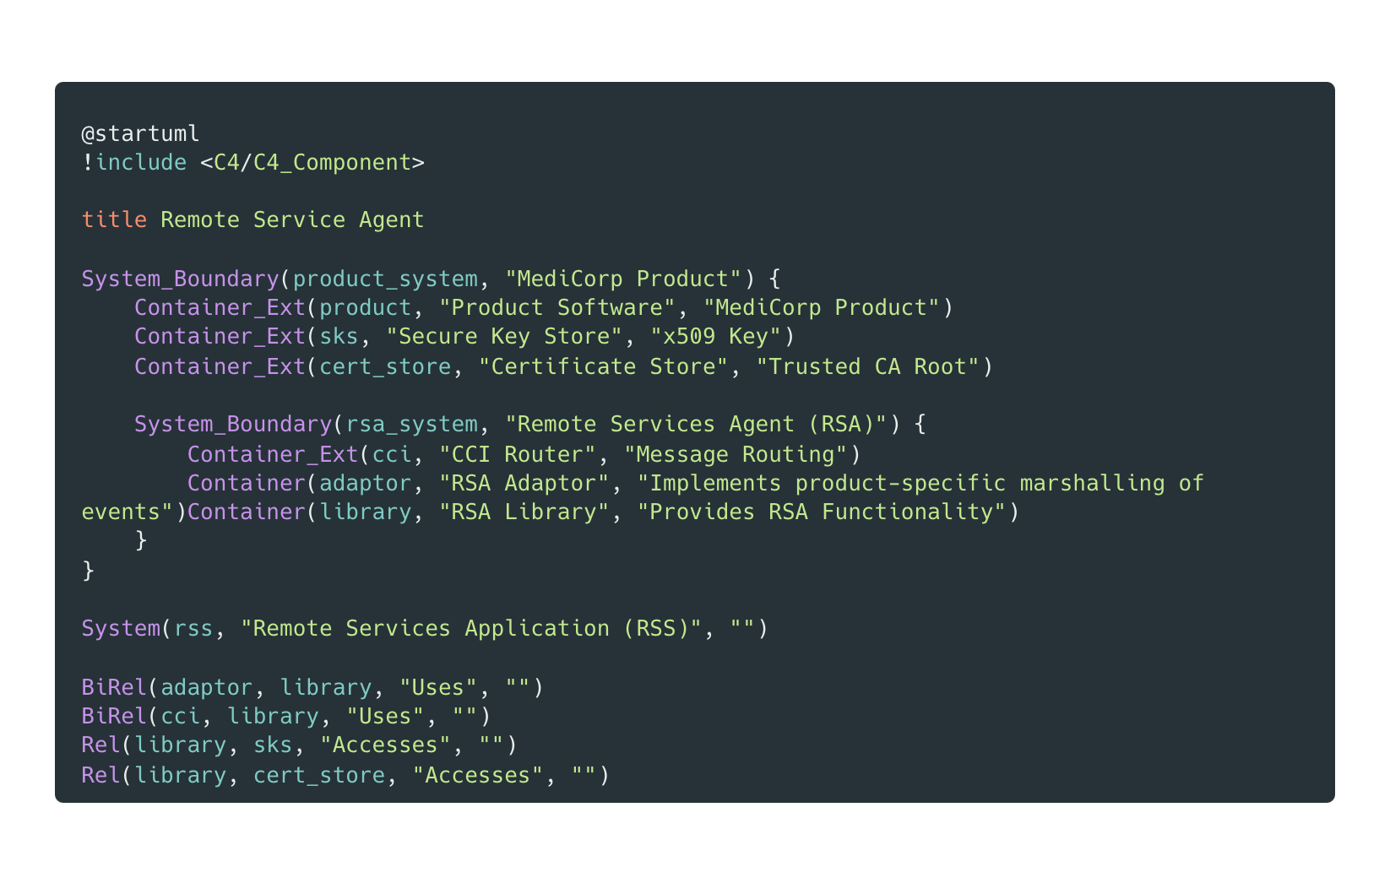
Notes:
01-plantuml-sequence.puml

Slide 36
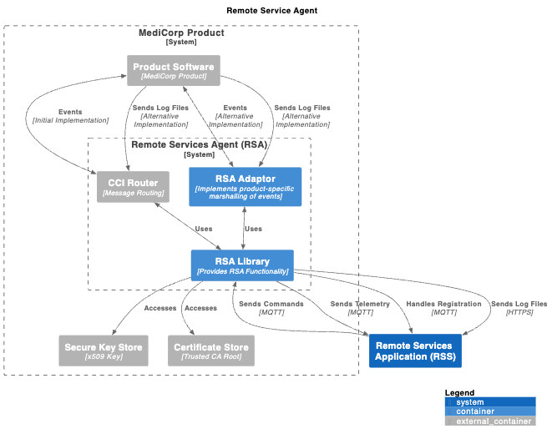
Notes:
01-plantuml-sequence.puml

Slide 37
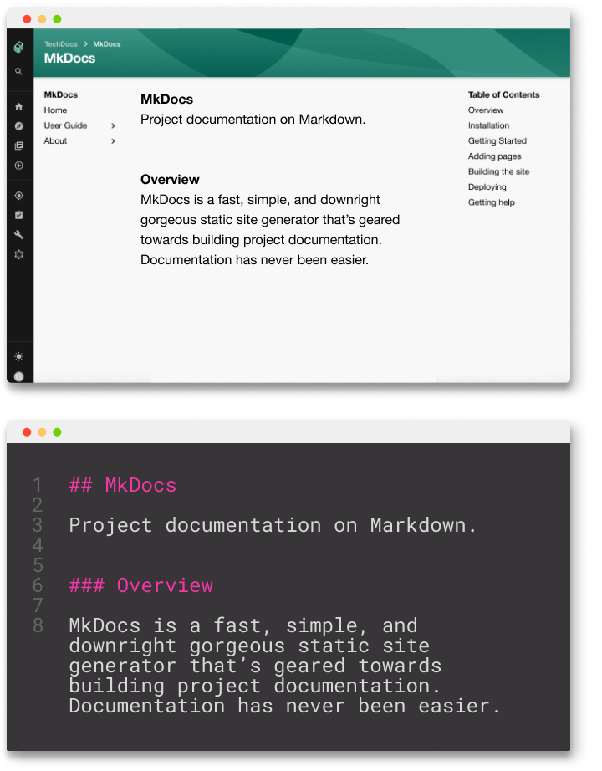
Bringing it all together
Add Markdown front-matter for metadata
Roll your own scripts
Output to PDF in CI/CD pipelines
Mkdocs & Mkdocs material 😍
Docusaurus 🦖
Notes:
Now there is a lot of documentation across multiple repos, how to make it searchable
https://adrianvlupu.github.io/C4-Builder/
https://pandoc.org/

Slide 38
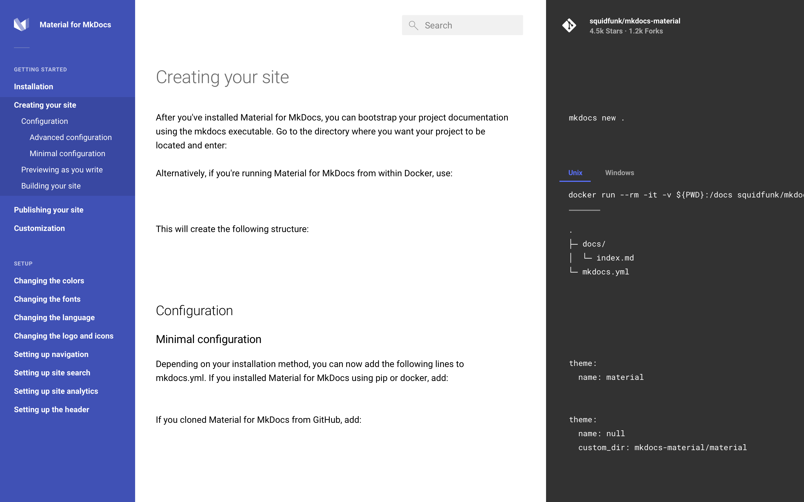
Mkdocs
& Material Design
Notes:
04-c4model-context-good.puml

Slide 39
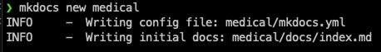
Demo
Mkdocs & Material

Slide 40
Questions?
Shawinnes.com

